Slide 1
Portfolio Hosting

Slide 2
What are we making?

Slide 3
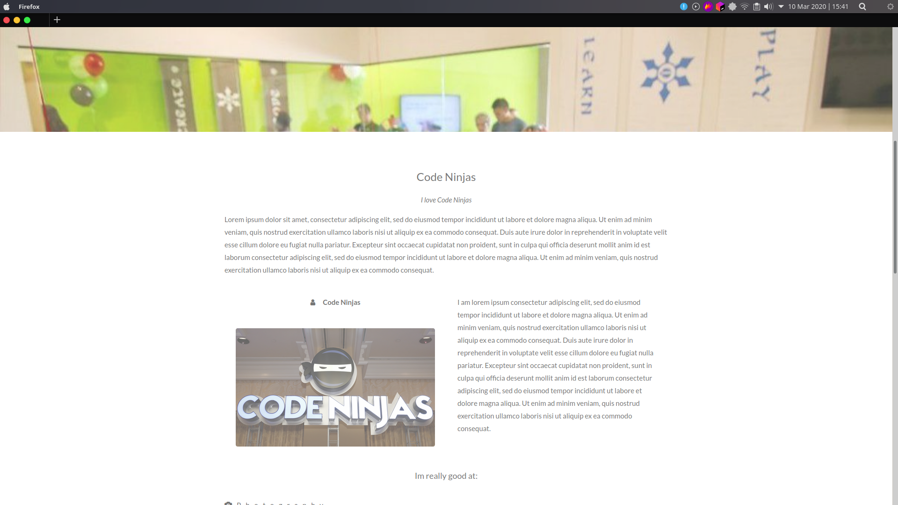
What are we making?

Slide 4
Let’s Get Ready!
We need:
Laptop
Raspberry Pi
Keyboard
Mouse
USB
Monitor
Power Source

Slide 5
Starter Files!
Head over to the google drive and download the starter files, design documents, and flowcharts and get started!
Make sure to say “apples” if you need help.

Slide 6
Let’s Get Coding!
Laptops
Press the Windows key.
Search “IDLE”
print(“Hello World”)

Slide 7
After You’re Done
Try going through the HTML under the ‘templates’ folder and see if you can customize the website for yourself!

